Slide 1
ECE 105: Introduction to Electrical Engineering
Lecture 13
Bio 3
Yasser Khan
Rehan Kapadia

Slide 2
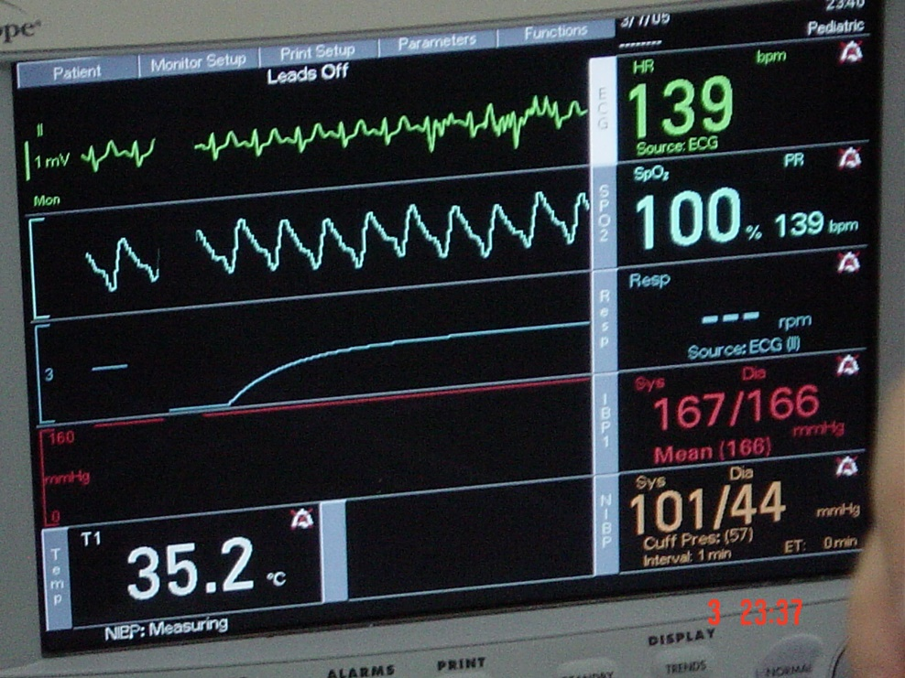
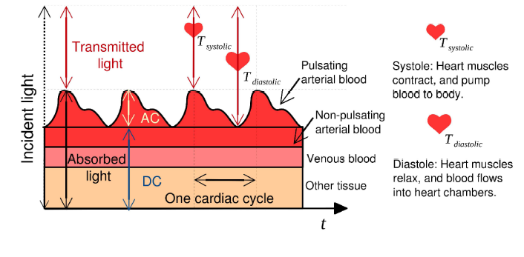
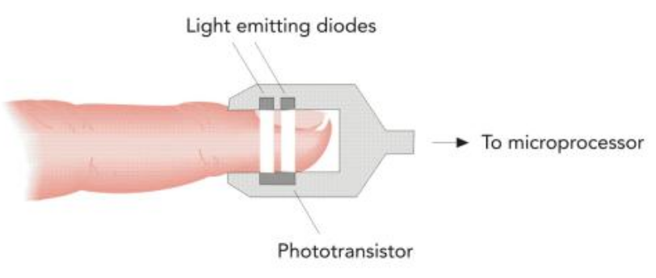
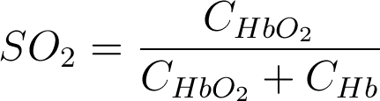
Pulse oximetry
ECG
Pulse oximetry measures blood oxygenation. Using spectrophotometry of absorptivity of blood at two distinct wavelengths, blood oxygen saturation is quantified.
Can detect hypoxemia, ie. lower than normal blood oxygenation.
Pulse Ox
Respiration
Blood
Pressure
Temperature
SO₂ The saturation of oxygen in blood,
C_{HbO2} Concentration of oxygenated hemoglobin (HbO₂),
C_{Hb} Concentration of deoxygenated hemoglobin (Hb).

Slide 3
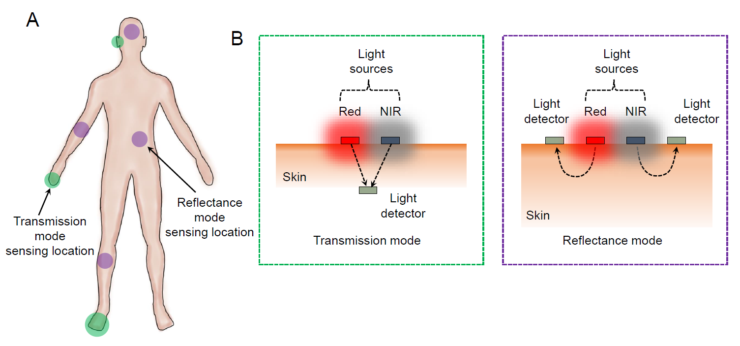
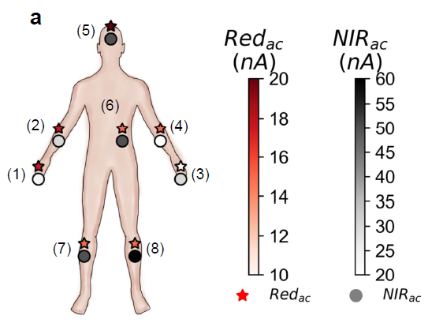
Transmission vs. reflectance oximetry
Transmission-mode pulse oximetry is limited only to tissues that can be transilluminated, such as the earlobes and the fingers.
If reflected light is used as the signal, the sensor can be used beyond the conventional sensing locations.
AC signal is the highest at the forehead for both Red and NIR channels.
Arms provide mid-range AC amplitude, while signal strength is low in the legs and chest area.
Forehead is the best location for reflectance pulse oximetry.

Slide 4
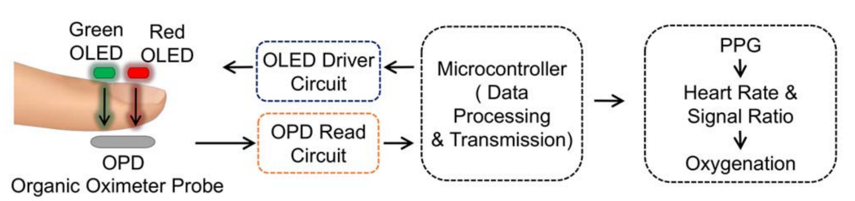
Oximeter readout circuit

Slide 5
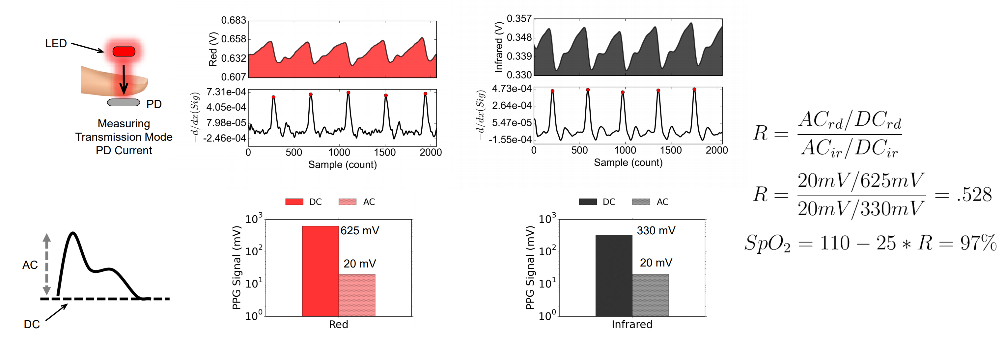
Calculating oxygen saturation

Slide 6
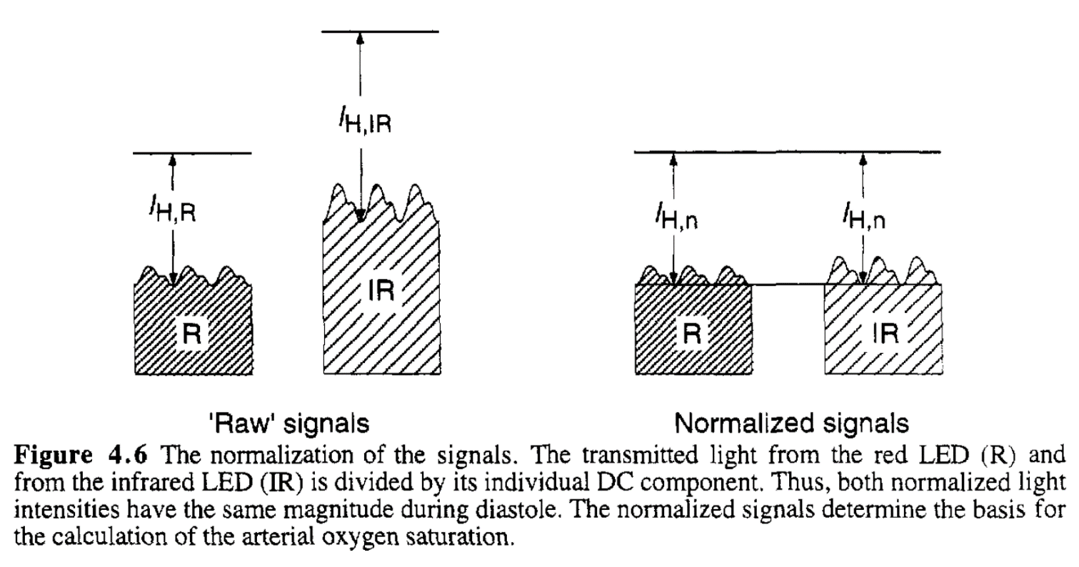
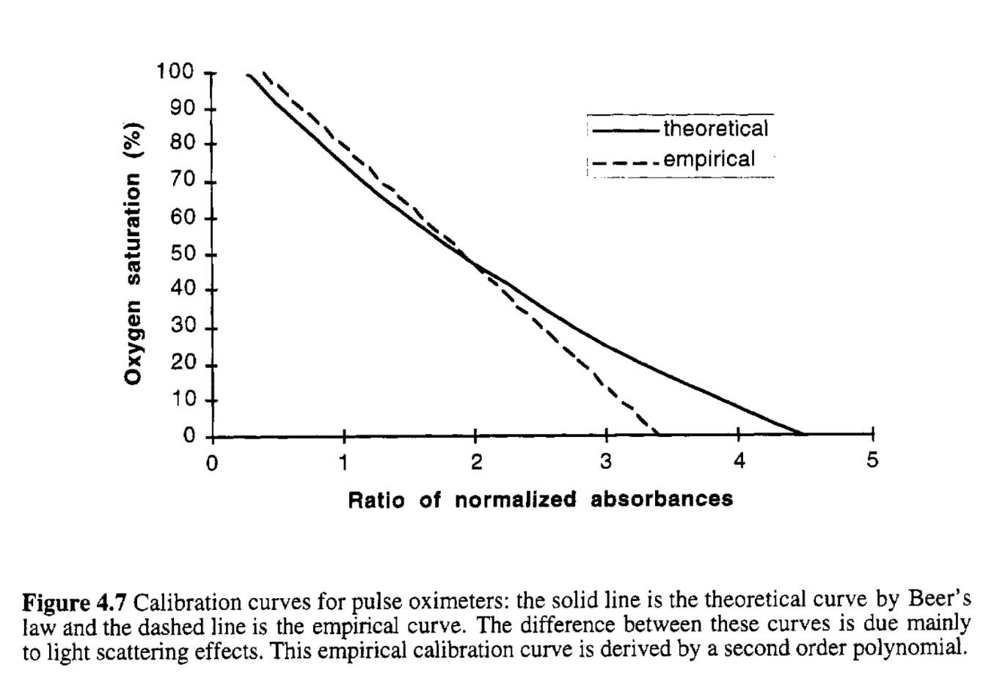
Pulse oximeter basics

Slide 7
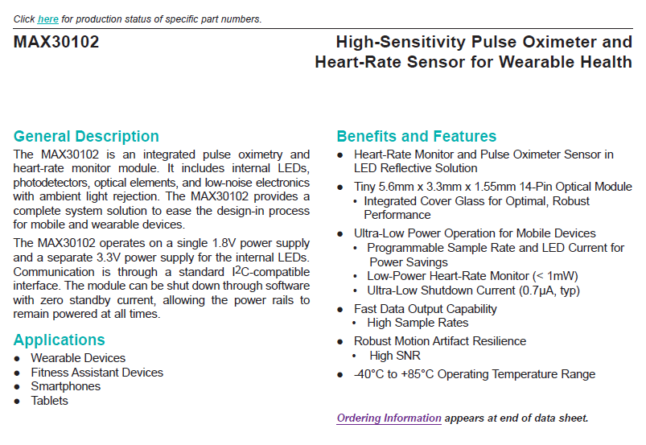

AFE – MAX30102

Slide 8
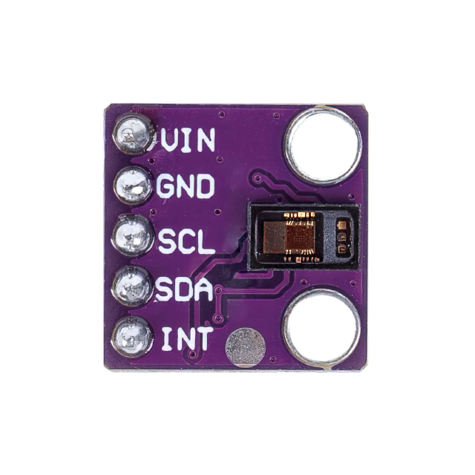
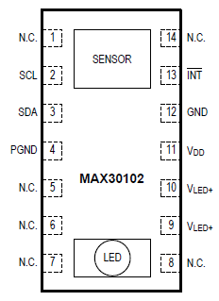
Connection

Slide 9
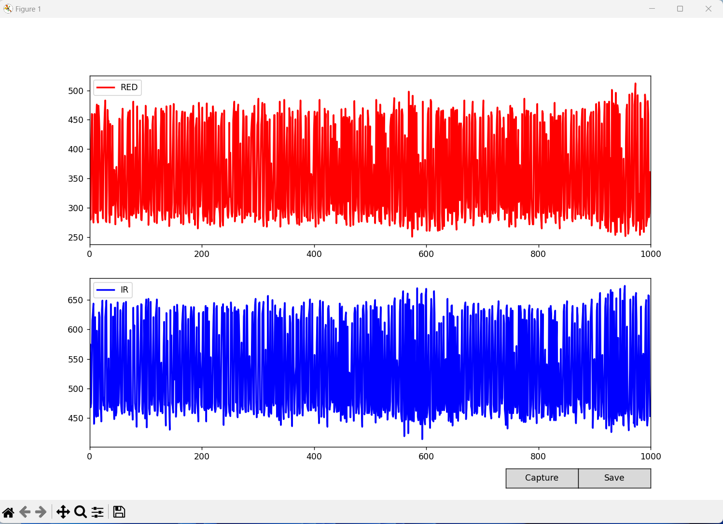
Press capture

Slide 10
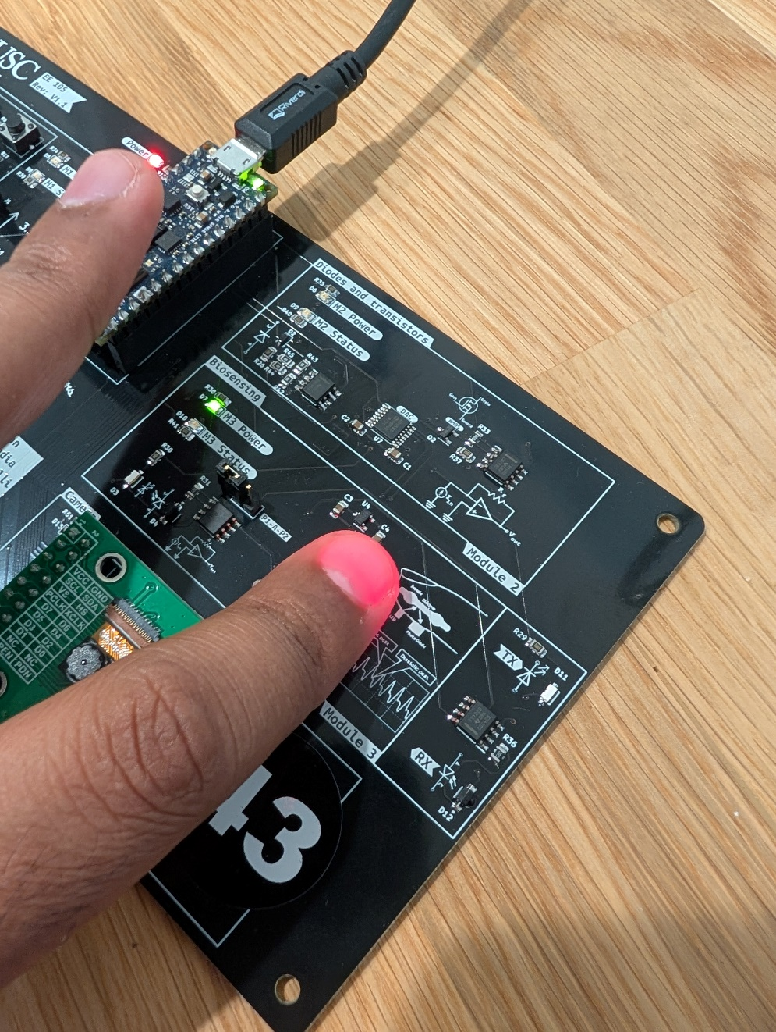
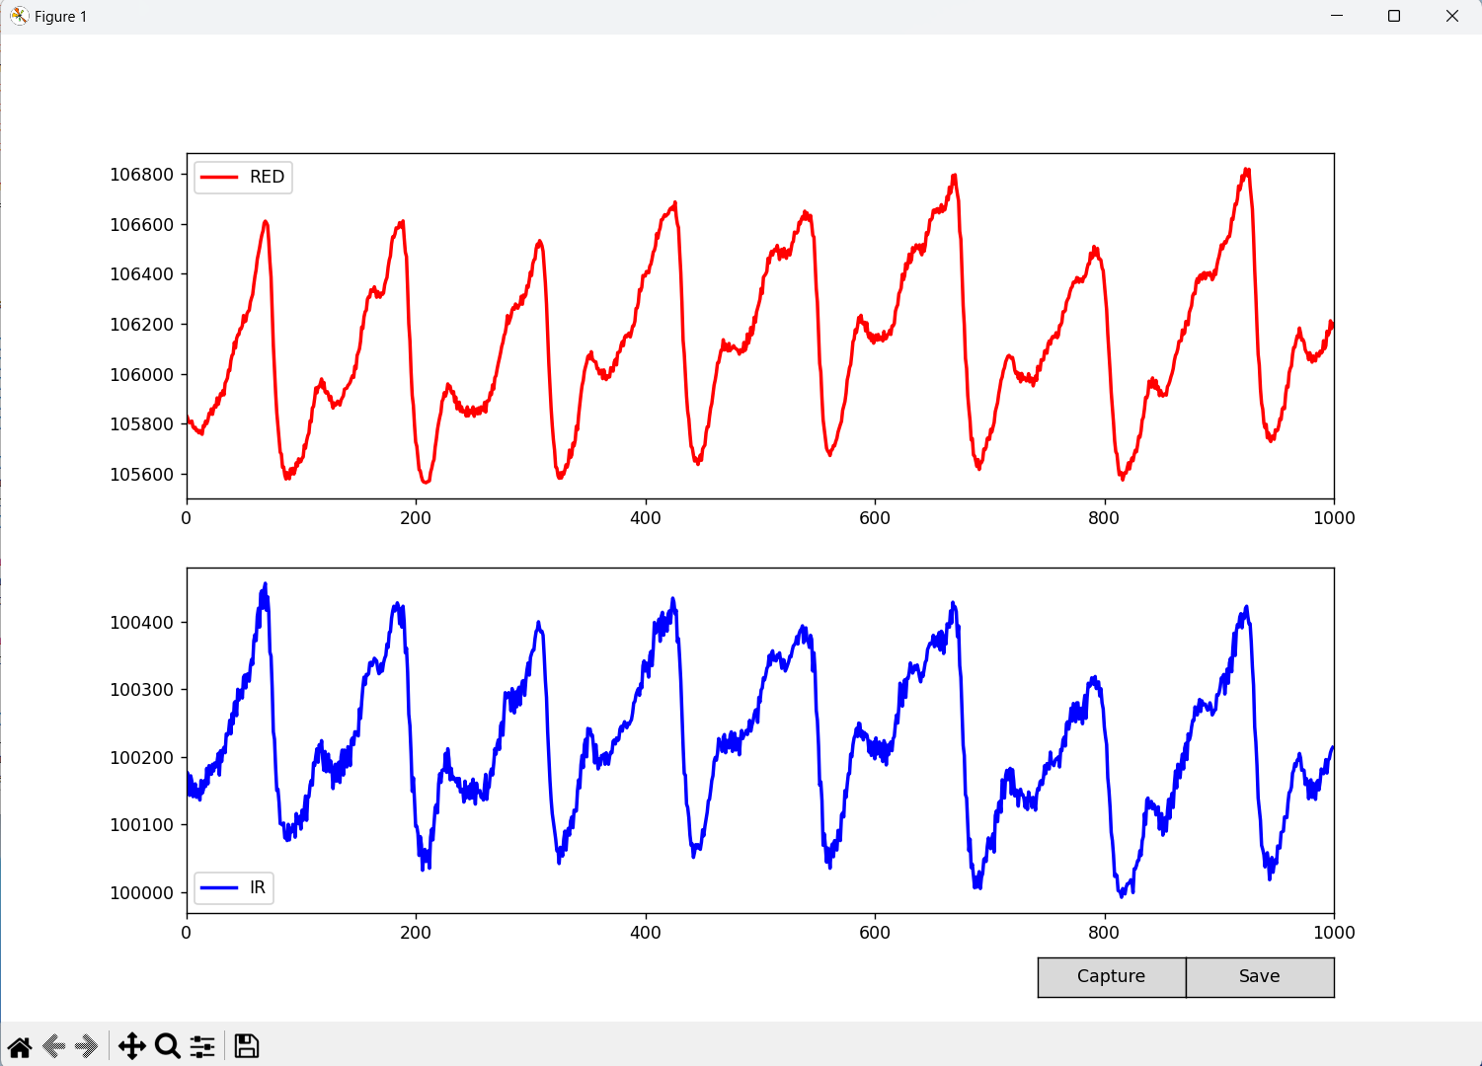
Keep your finger gently on the sensor

Slide 11
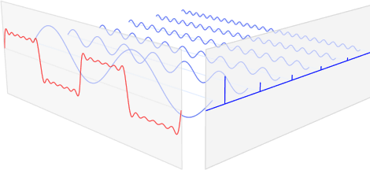
Time domain to frequency domain
The Fourier transform is an analysis process, decomposing a complex-valued function into its constituent frequencies and their amplitudes.

Slide 12
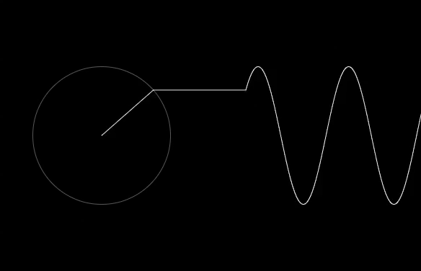
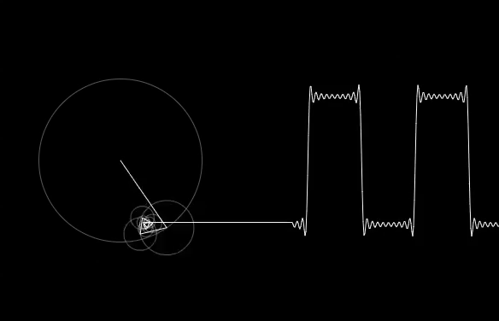
Time domain to frequency domain
The Fourier transform is an analysis process, decomposing a complex-valued function into its constituent frequencies and their amplitudes.

Slide 13
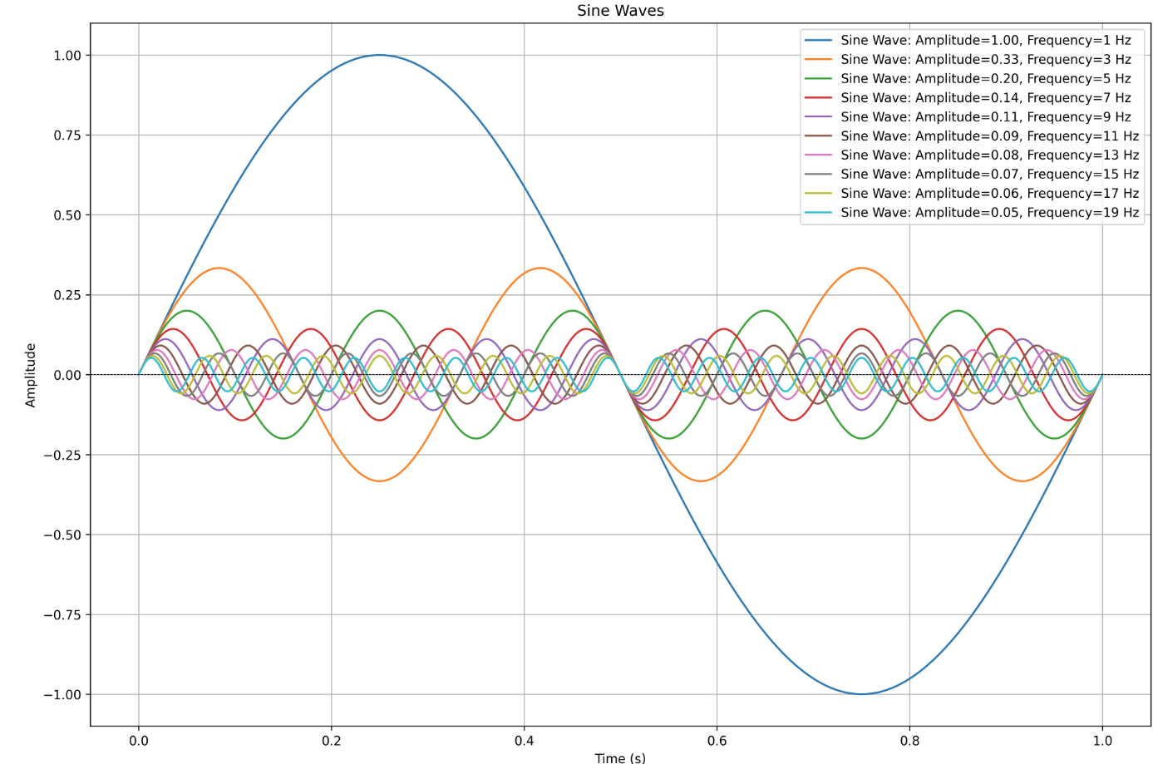
Time domain to frequency domain

Slide 14
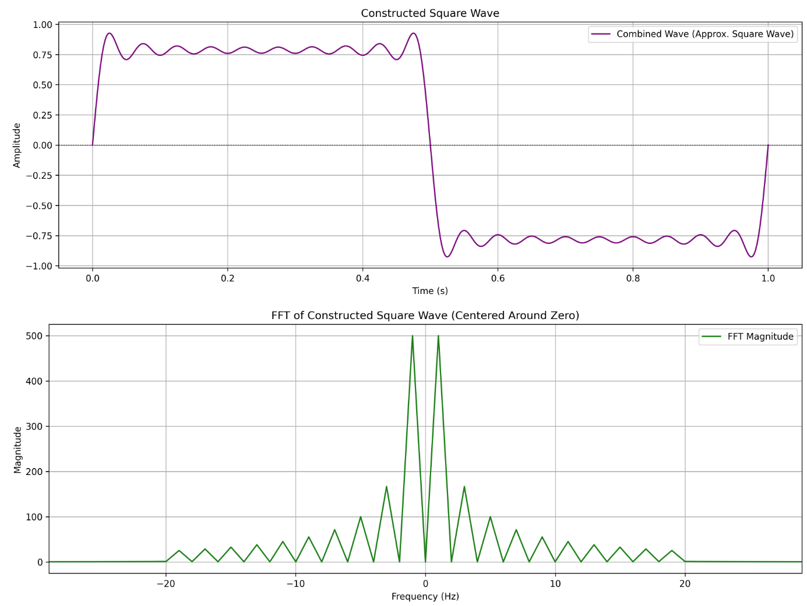
What makes a square wave

Slide 15
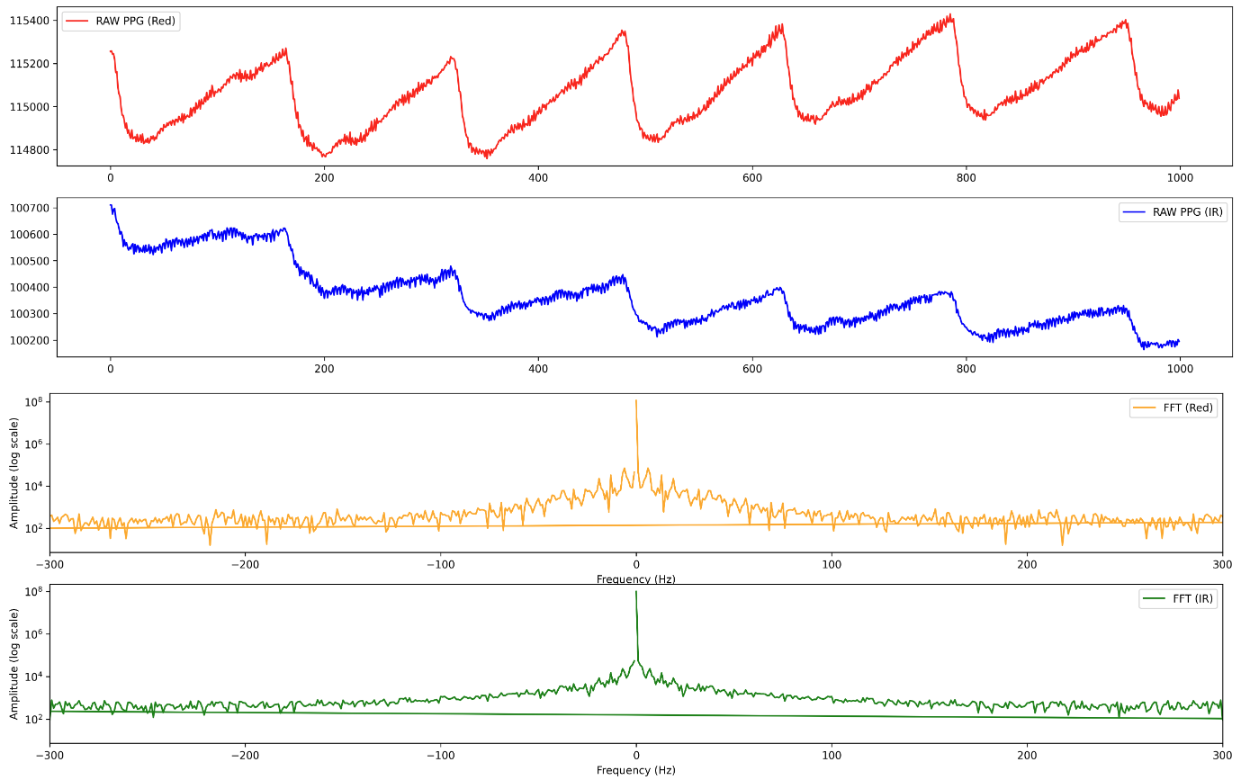
Going back to the PPG data collected

Slide 16
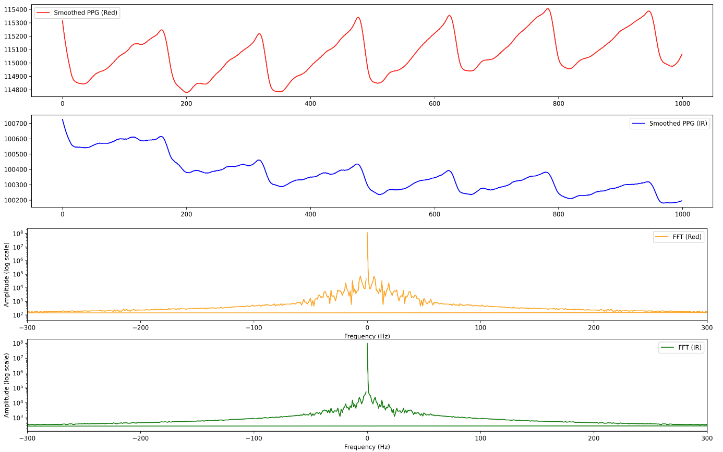
Smoothing

Slide 17
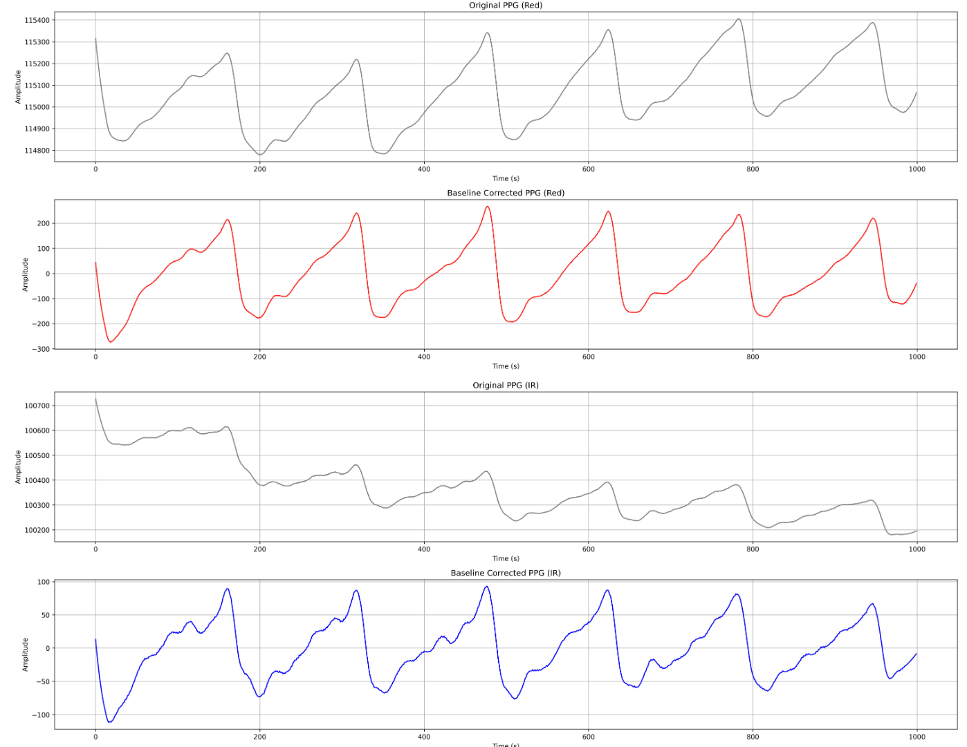
Drift correction

Slide 18
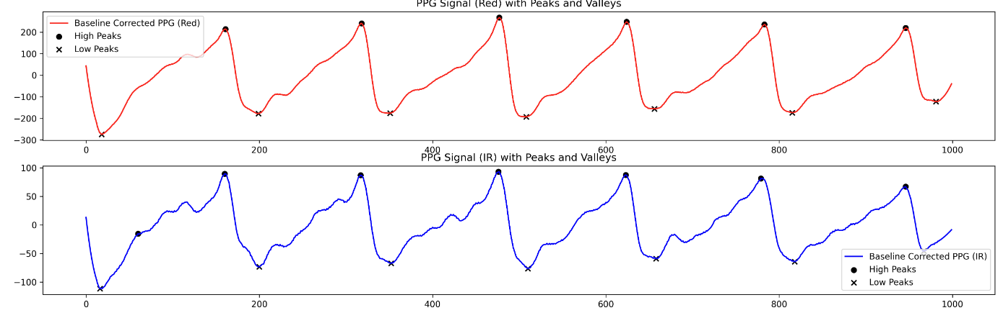
Peak detection

Slide 19
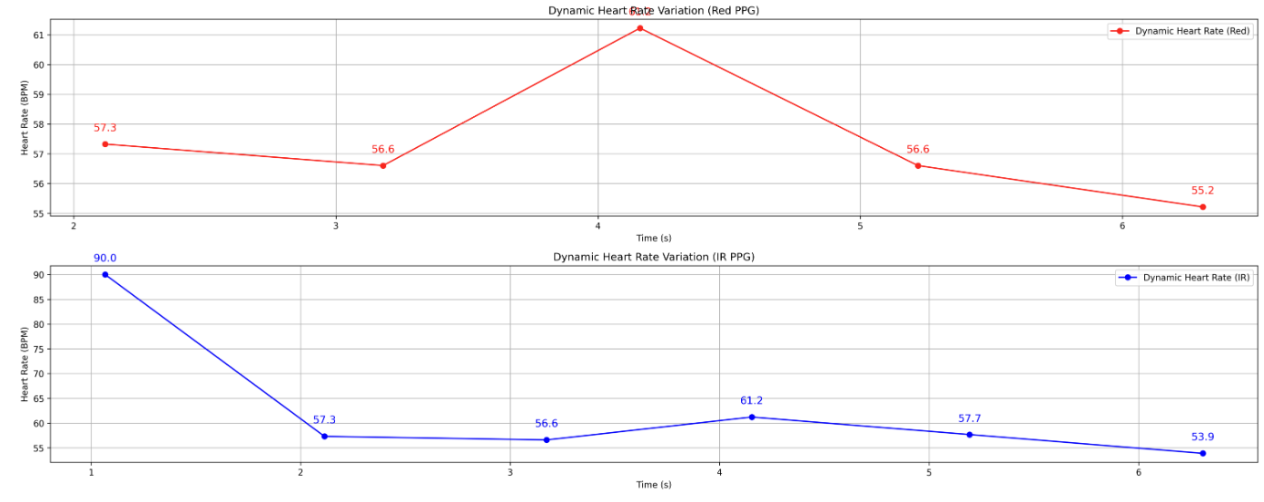
Heart rate

Slide 20
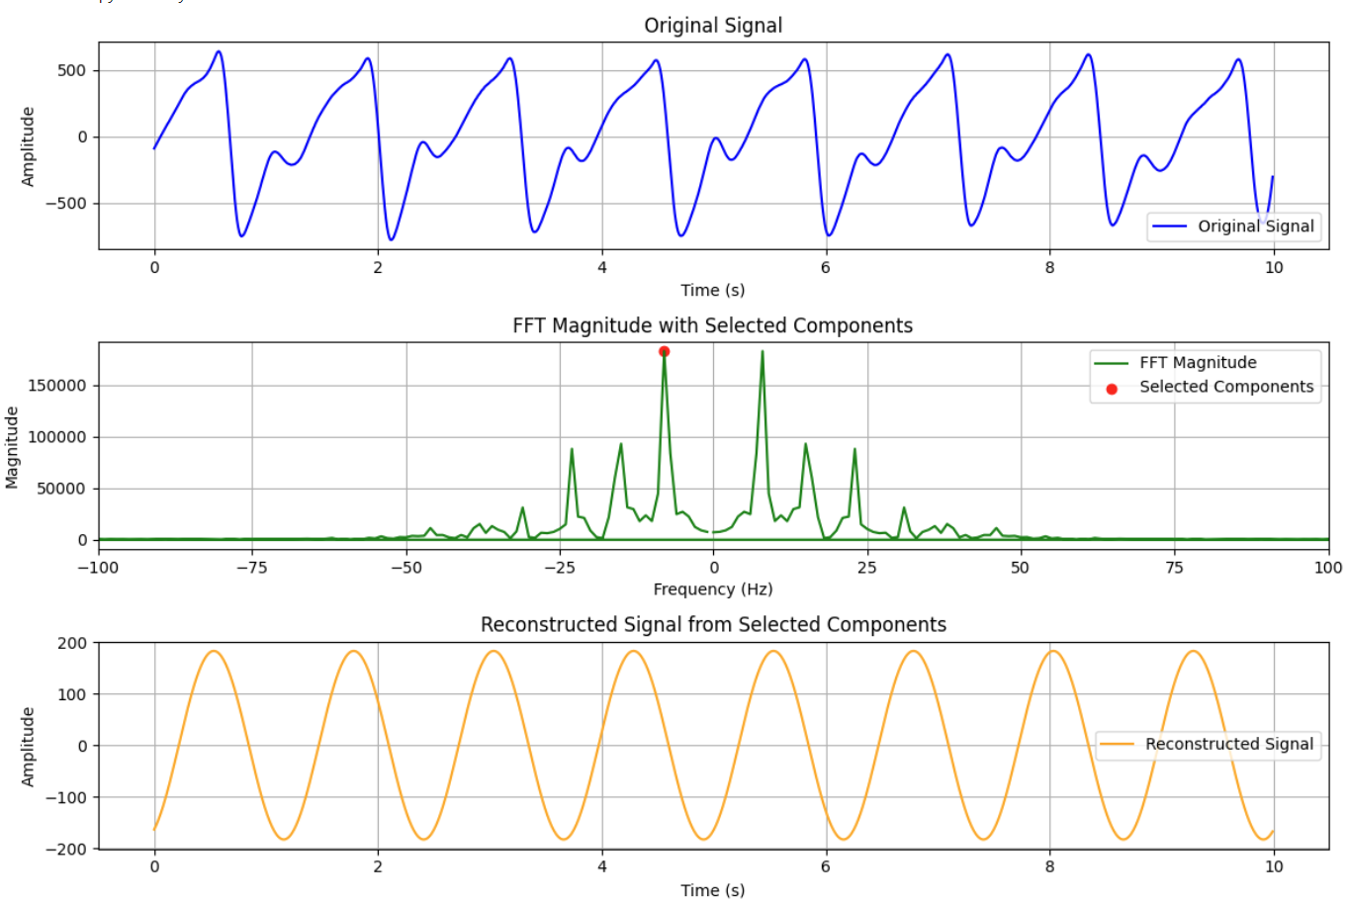
Using single component to find heart rate

Slide 21
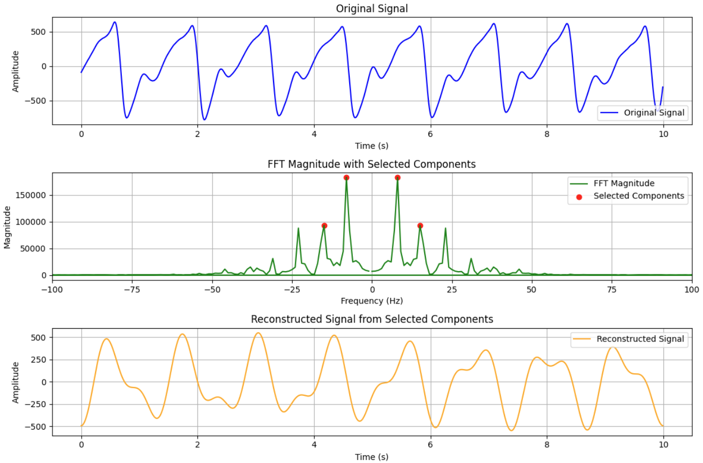
4 components in the PPG signal – signal loss

Slide 22
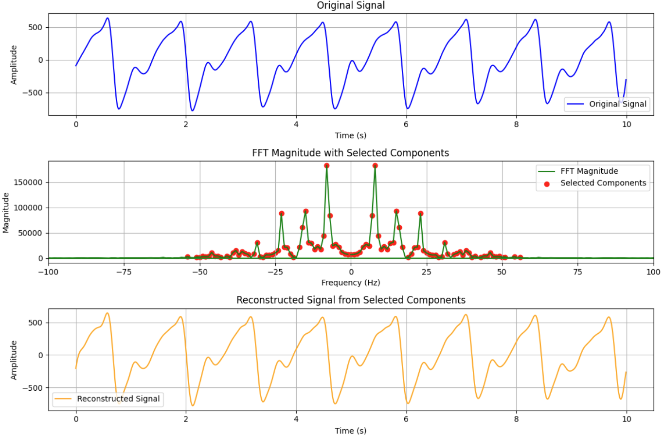
Taking all the components provides the original signal

Slide 23
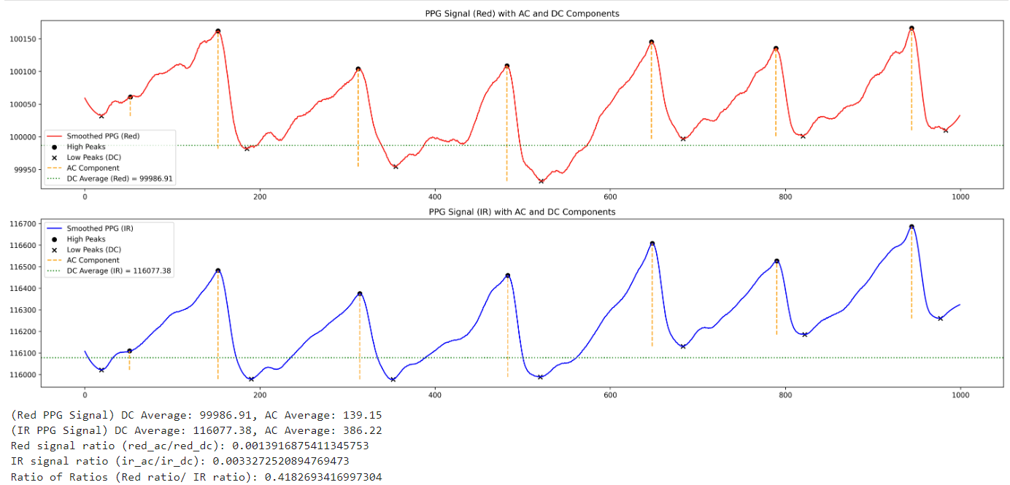
Ratio of the ratios

Slide 24
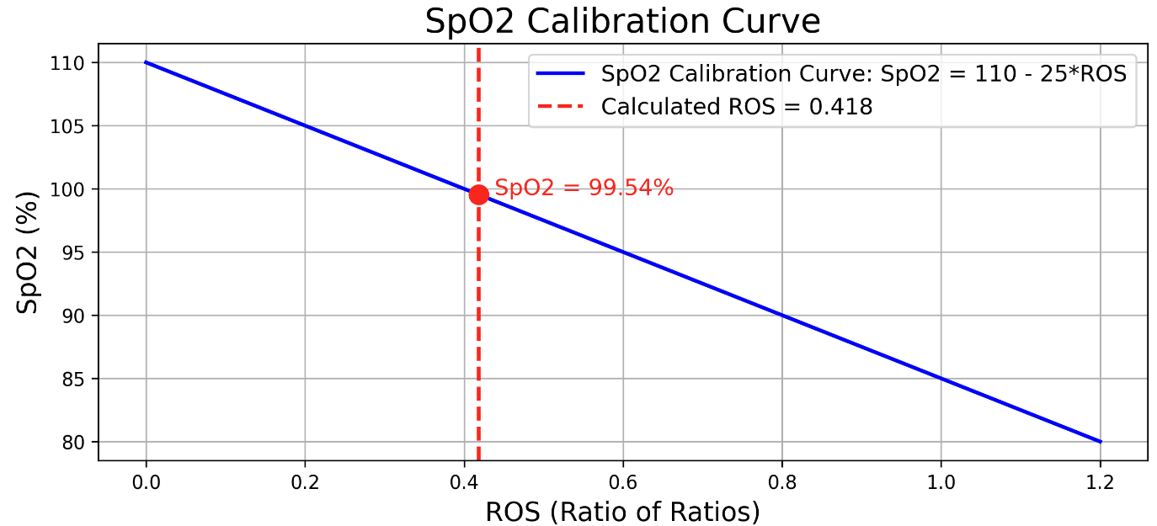
SpO2 calculation

